Slide 1
Student Performance Analysis
Team Mercury
Netflix-Data Science Bootcamp Project 1
Members: Fana Wachamo, Charne Jewell-Hart, Debora Rogers, and Amon Thomas
Date:3/4/2021

Slide 2
Overview
For this project, we will use a dataset of test scores from 1000 students found on data.world.com. Students performances on the tests vary considering the other factors included.We will then used the information from the dataset to determine if there is any correlation between the exam scores and the other factors in the dataset. We will use Matplotlib, Jupyter Notebook, and other resources to clean the data and test the different datasets in order to find how the factors affect the student’s exam scores. After the analysis was complete, we will be able to answer questions we have about the data and be able to support it with statistical data.

Slide 3
Questions
How does parental education level affect student performance, does higher parental education lead to better test scores?
How does the average exam score compare for students who prepared to those who did not?
How does the exam performance compare for students with free or reduced lunch versus standard lunch?
Does race/ethnicity affect students’ exam performance?
Does increases in student’s reading scores also increase scores in math and writing?

Slide 4
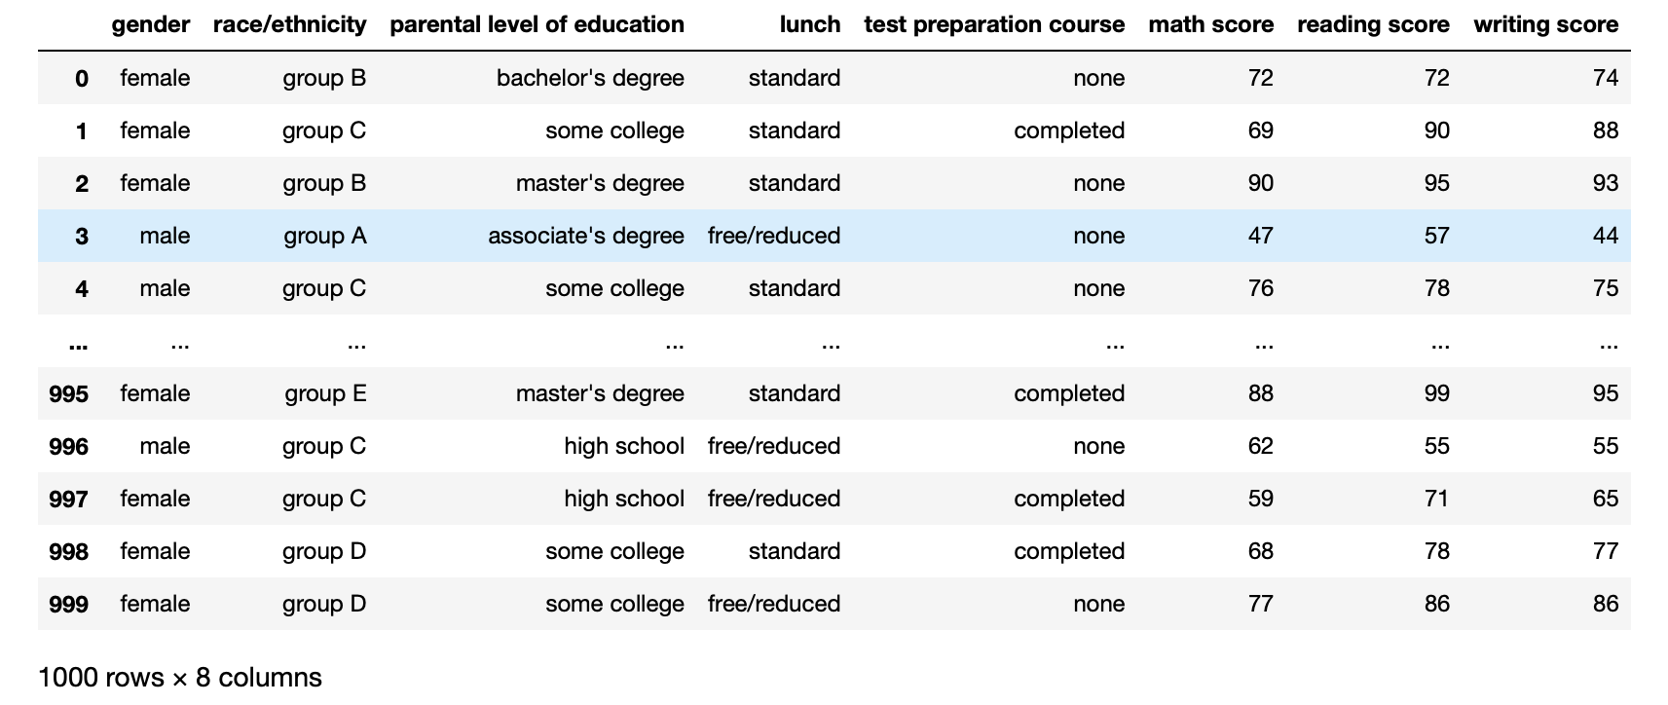
DataSet
Notes:
The dataset we used was a dataset, StudentsPerformace.csv, which was retrieved from data.world.com. That includes the following:
Race/ethnic groups
Lunch
Parent’s level of education
Test prep completion
Math,reading ,and writing score
Gender
The data had already been formated and required no cleaning . All cells matched in data type and there were no empty cells. We added an additional column, called average that was made for the inclusion of an “average” column which we used to evaluate the student’s grades overall.

Slide 5
Motivation
Our motivation for this project was to understand how the various factors affect the overall performance of the students. Since all the members in the group are passionate about our academics, we felt that analyzing this data would peak interest in pinpointing factors that could improve the scores of students. The factors could be further studied to identify the best ways to implement these factors into current students. The data collected could also prove, or disprove, assumptions that may have been made in regard to student performance.

Slide 6
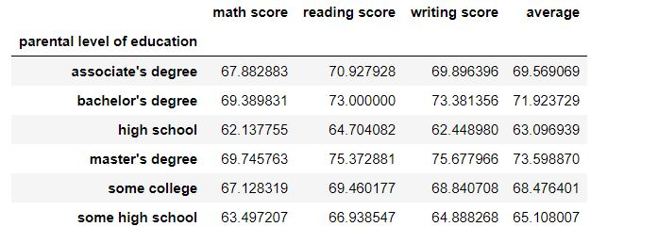
How the parental education level affect student performance, does higher parental education lead to better test scores?
Notes:
In order to answer this question we first grouped the data into 6 separate dataframes in order to represent the degree levels.
Using the “parental level of education” and the added “average” column, the data was converted to a box graph,created with plotly express, that displayed the distribution and other statistical values.
The next step we took was to get the total average for each dataframe using the mean() function which was used to represent each degree average as a whole.
The final step for this question was to create a line chart that displayed the total degree average vs the level of education. This graph was used to show how the averages change as the level of education increased.

Slide 7
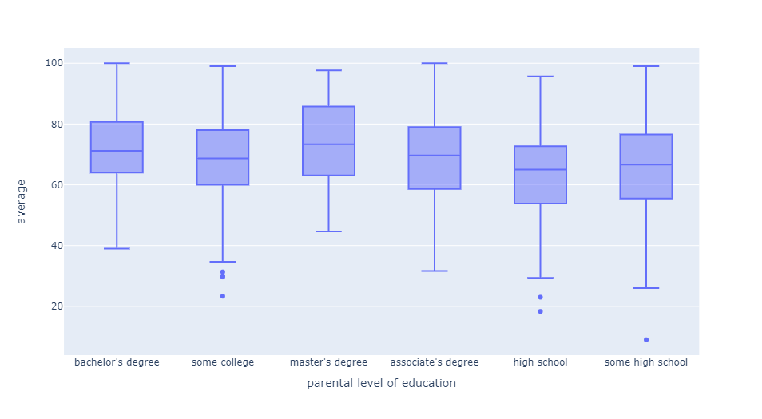
Parental level of education vs Scores
Notes:
This graph displays the distribution of each students average (their math, reading, and writing score) which shows that for each each of the degrees have students that scored more than 95 however a majority of the scores were within the 20 point range.
You also see those with degree had no outliers and kept within the range.
Finally you see that the medians are are in between the high 60 and low 70’s which agree with the grading scale of a ‘C’ letter grade being average.

Slide 8
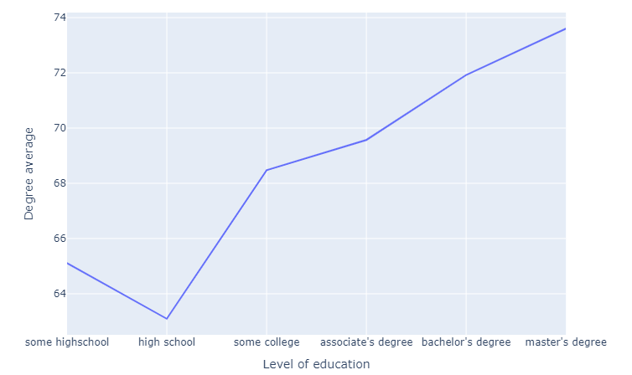
Parental level of education vs Scores

Slide 9
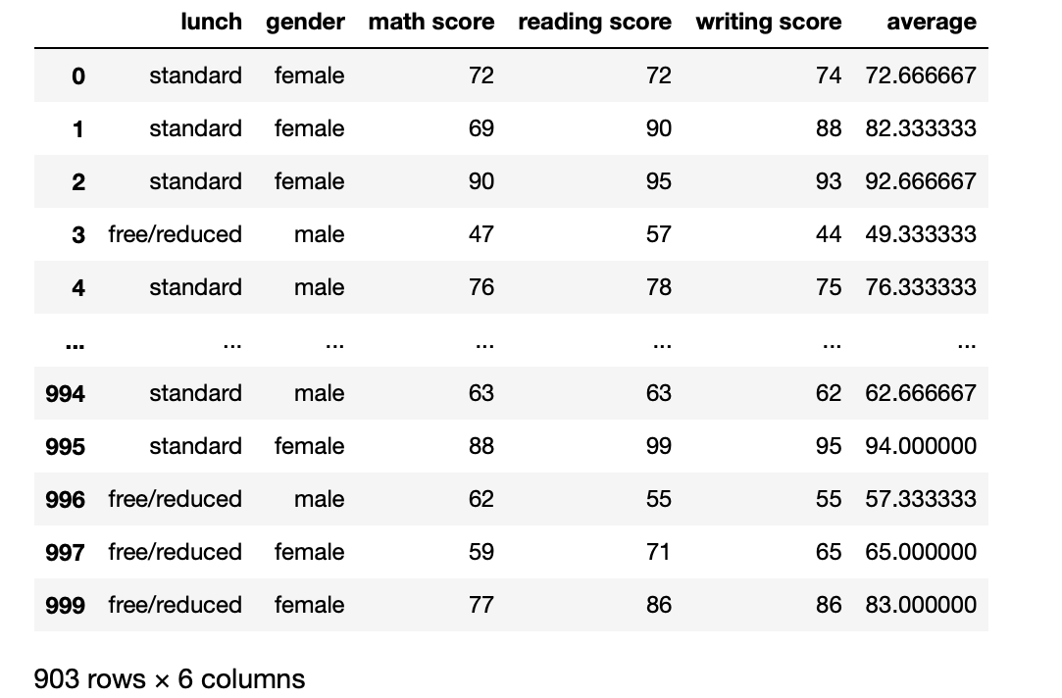
Does race/ethnicity affect students’ exam performance?
How does the exam performance compare for students with free or reduced lunch versus standard lunch?
Notes:
Here data is retrieved from the dataframe that was created to hold the data. We use the lunch type,(standard or free/reduced), and average exam scores in order to plot the data in order to test the data.

Slide 10
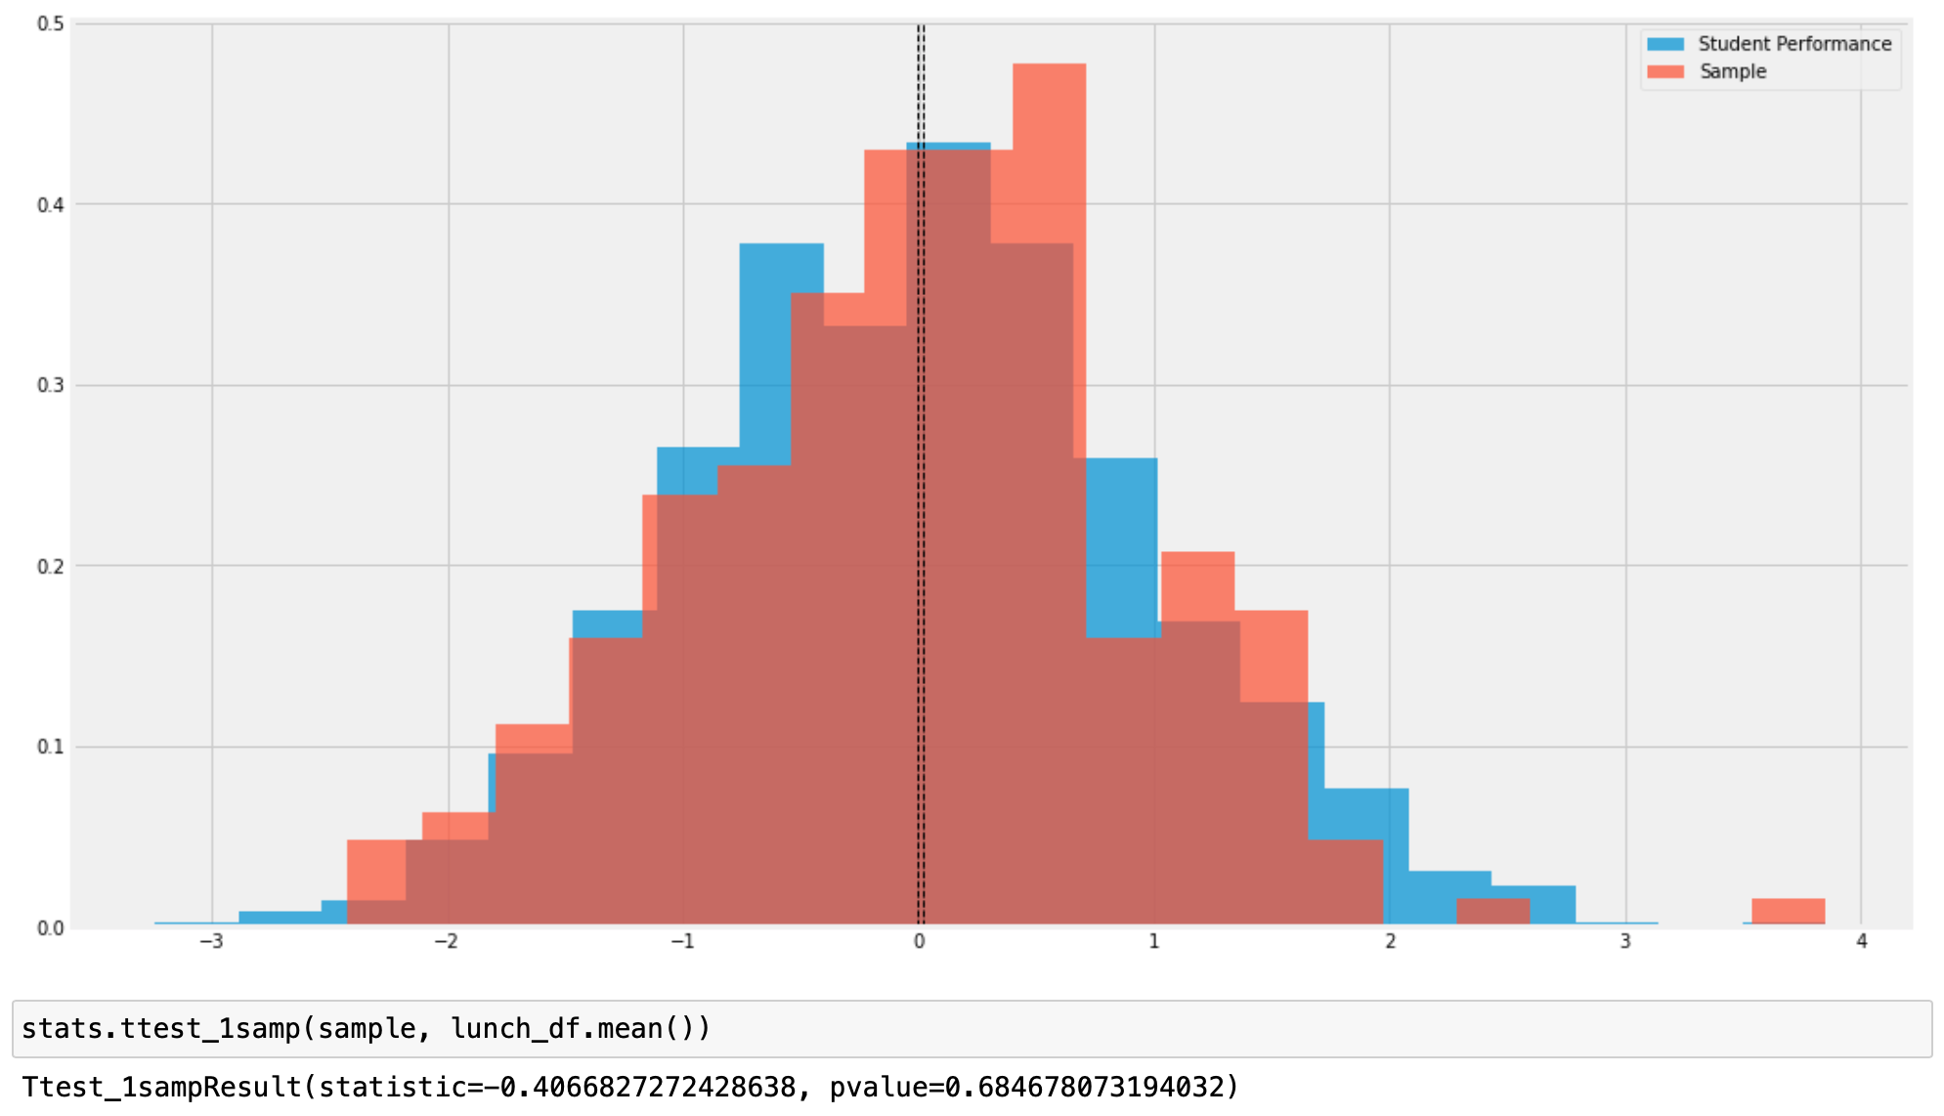
How does the exam performance compare for students with free or reduced lunch versus standard lunch?
Notes:
Here we analyzed the student lunch status versus exam scores utilizing a histogram. We generated sample data in order to evaluate the NULL hypothesis that student lunch status effects student performance. The means were compared for students w/ standard lunch vs free/reduced lunch. Using a t-test we obtained a t-statistic of -0.41 with a p-value of 0.68. The large p value gives the indication that either a non significant trend exists or that the evidence isn’t sufficient enough to suggest that lunch status affects student performance.

Slide 11
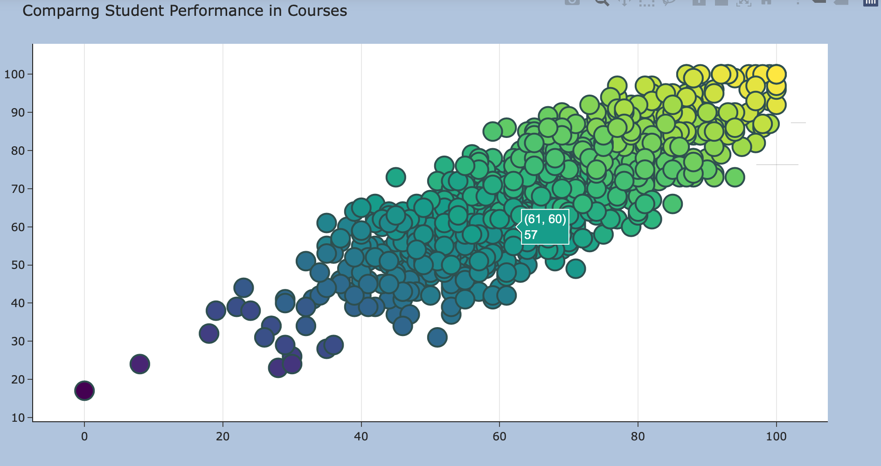
Does increases in the students reading score also affect math and writing scores?
Notes:
The visualization about shows a plot of the student exam scores( math scores are on the x axis, reading scores on the y axis, the colors represent the student average exam scores , with the darker purple representing the low scores. You see regression as the reading scores increase so does the math and writing. We also have a hover text which reflects the writing scores . This visualization suggests that higher score in reading scores does affect student performance in math and writing.

Slide 12
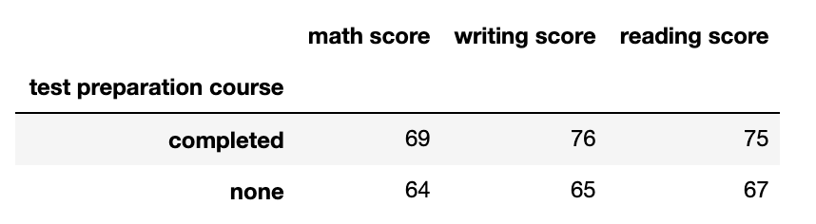
How does the average exam score compare for students who prepared for those who did not?

Slide 13
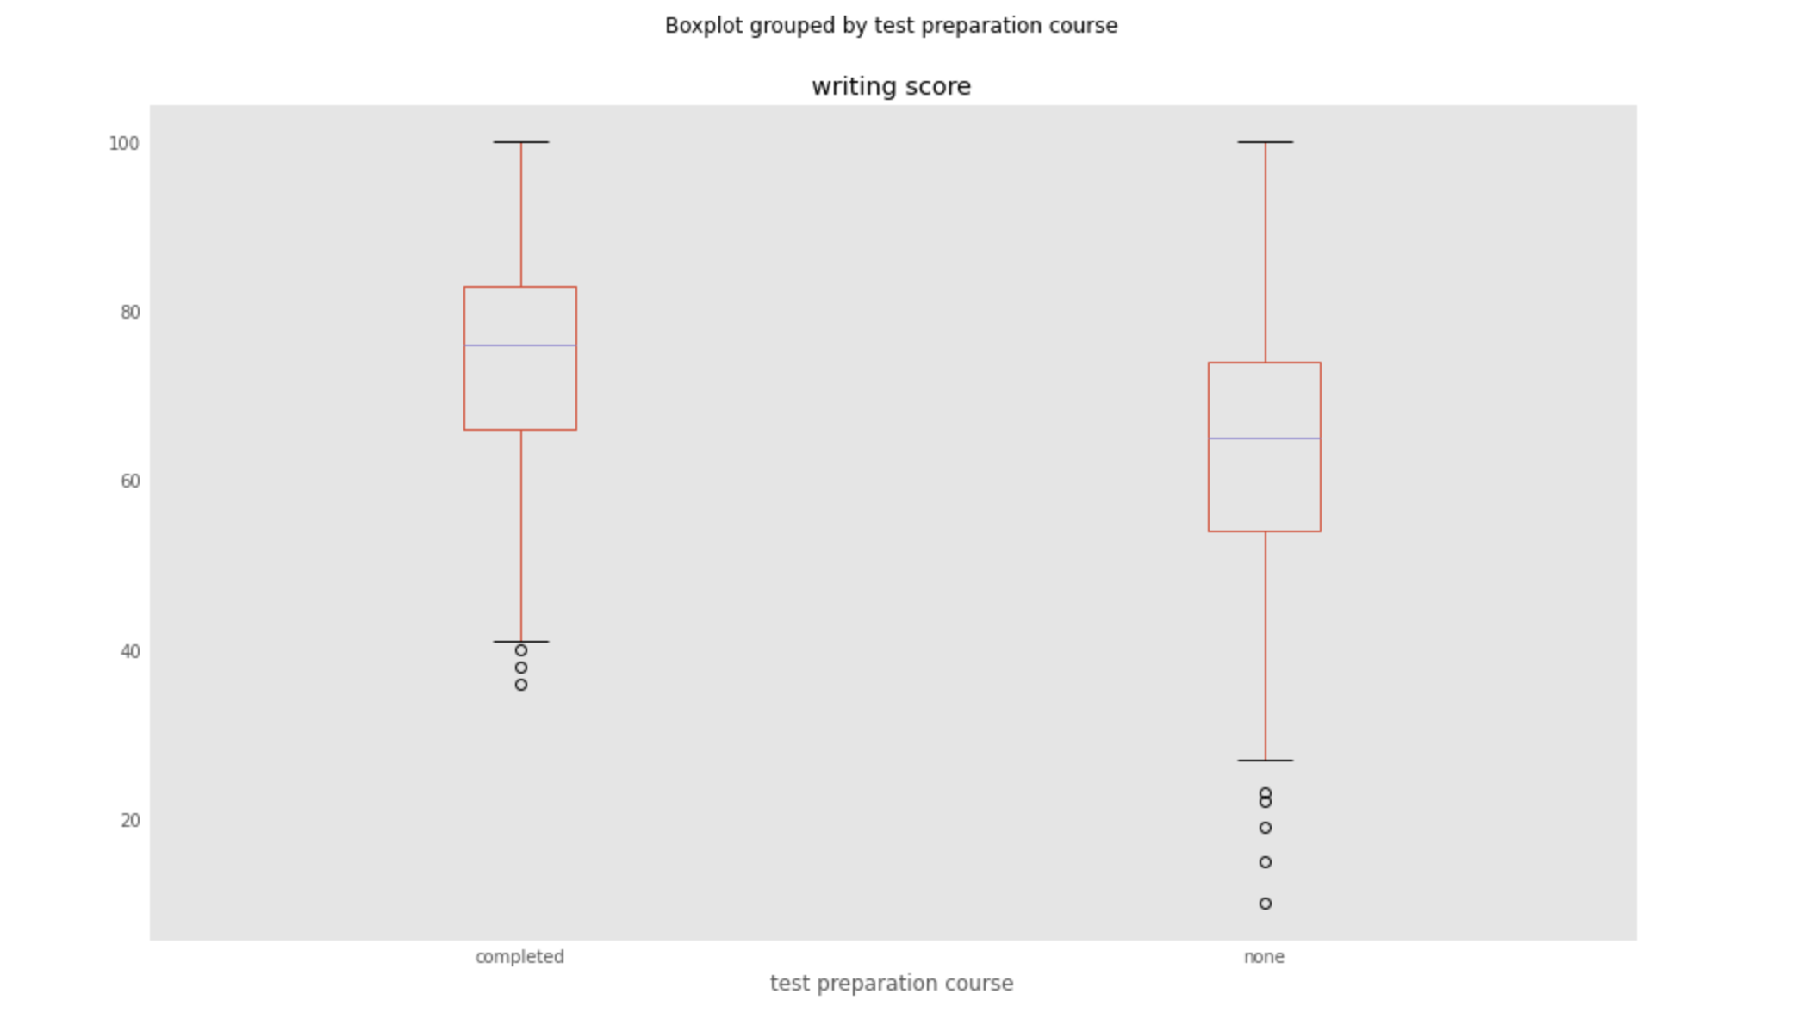
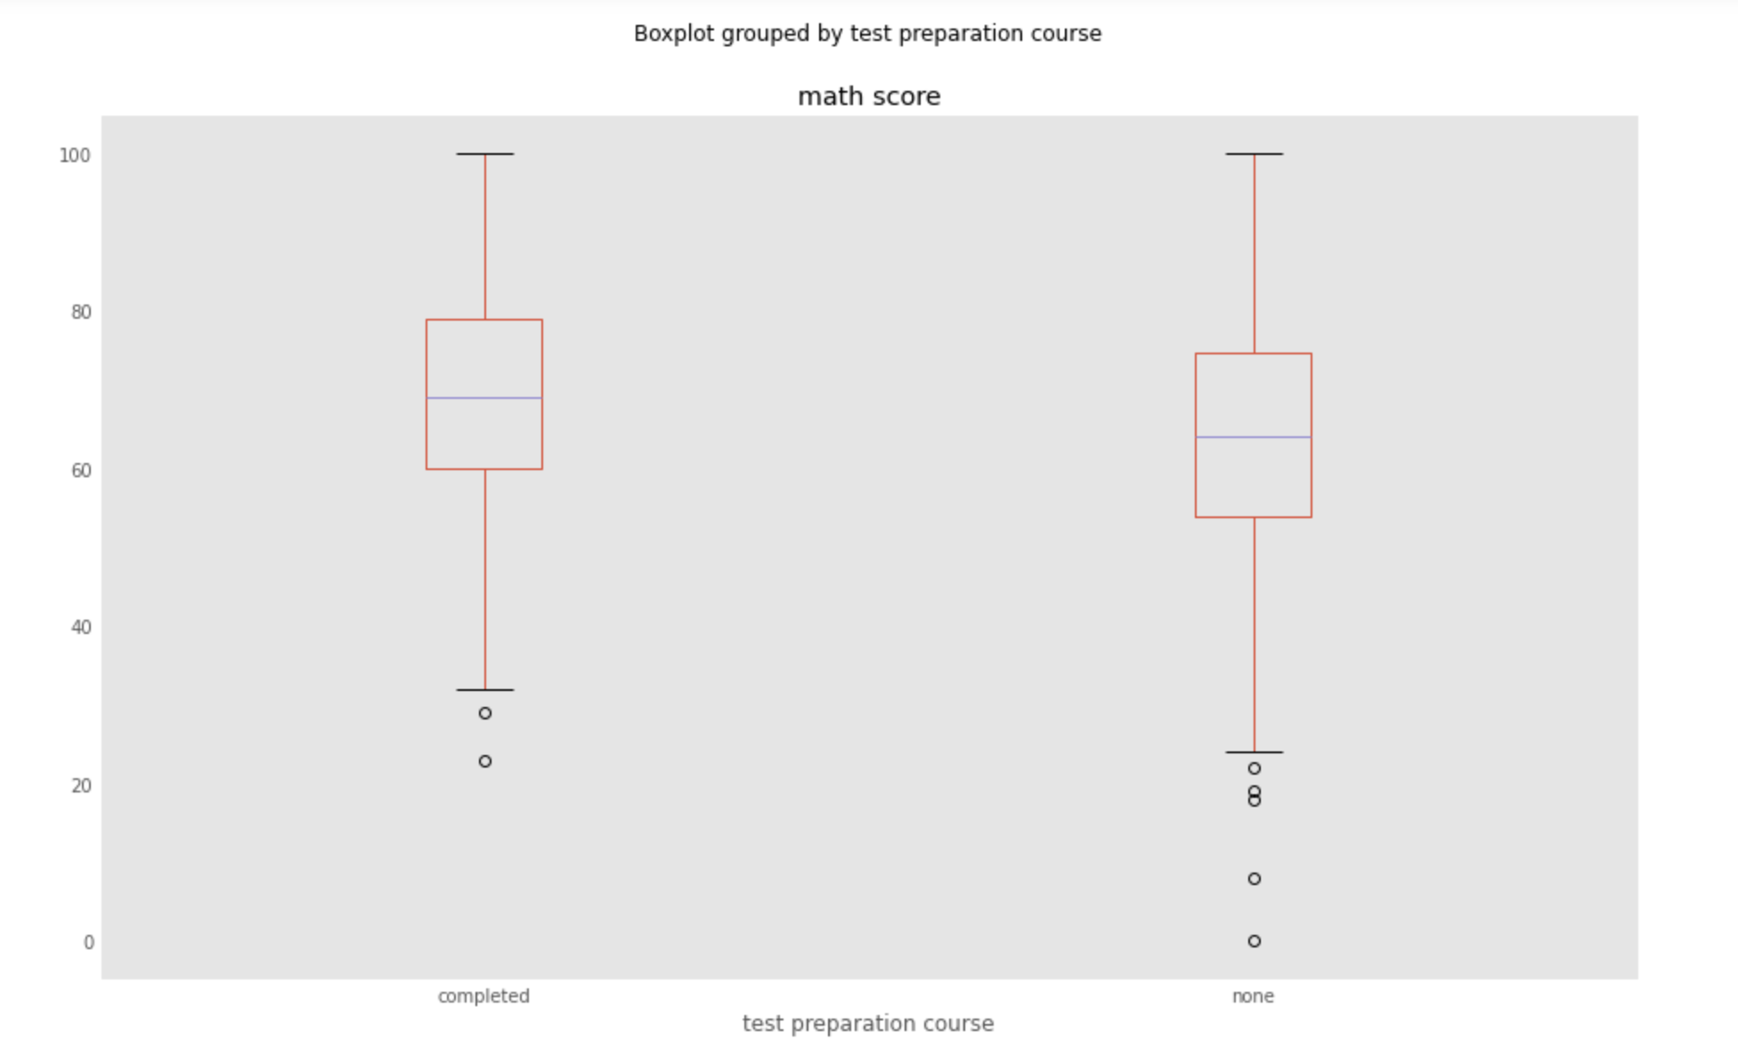
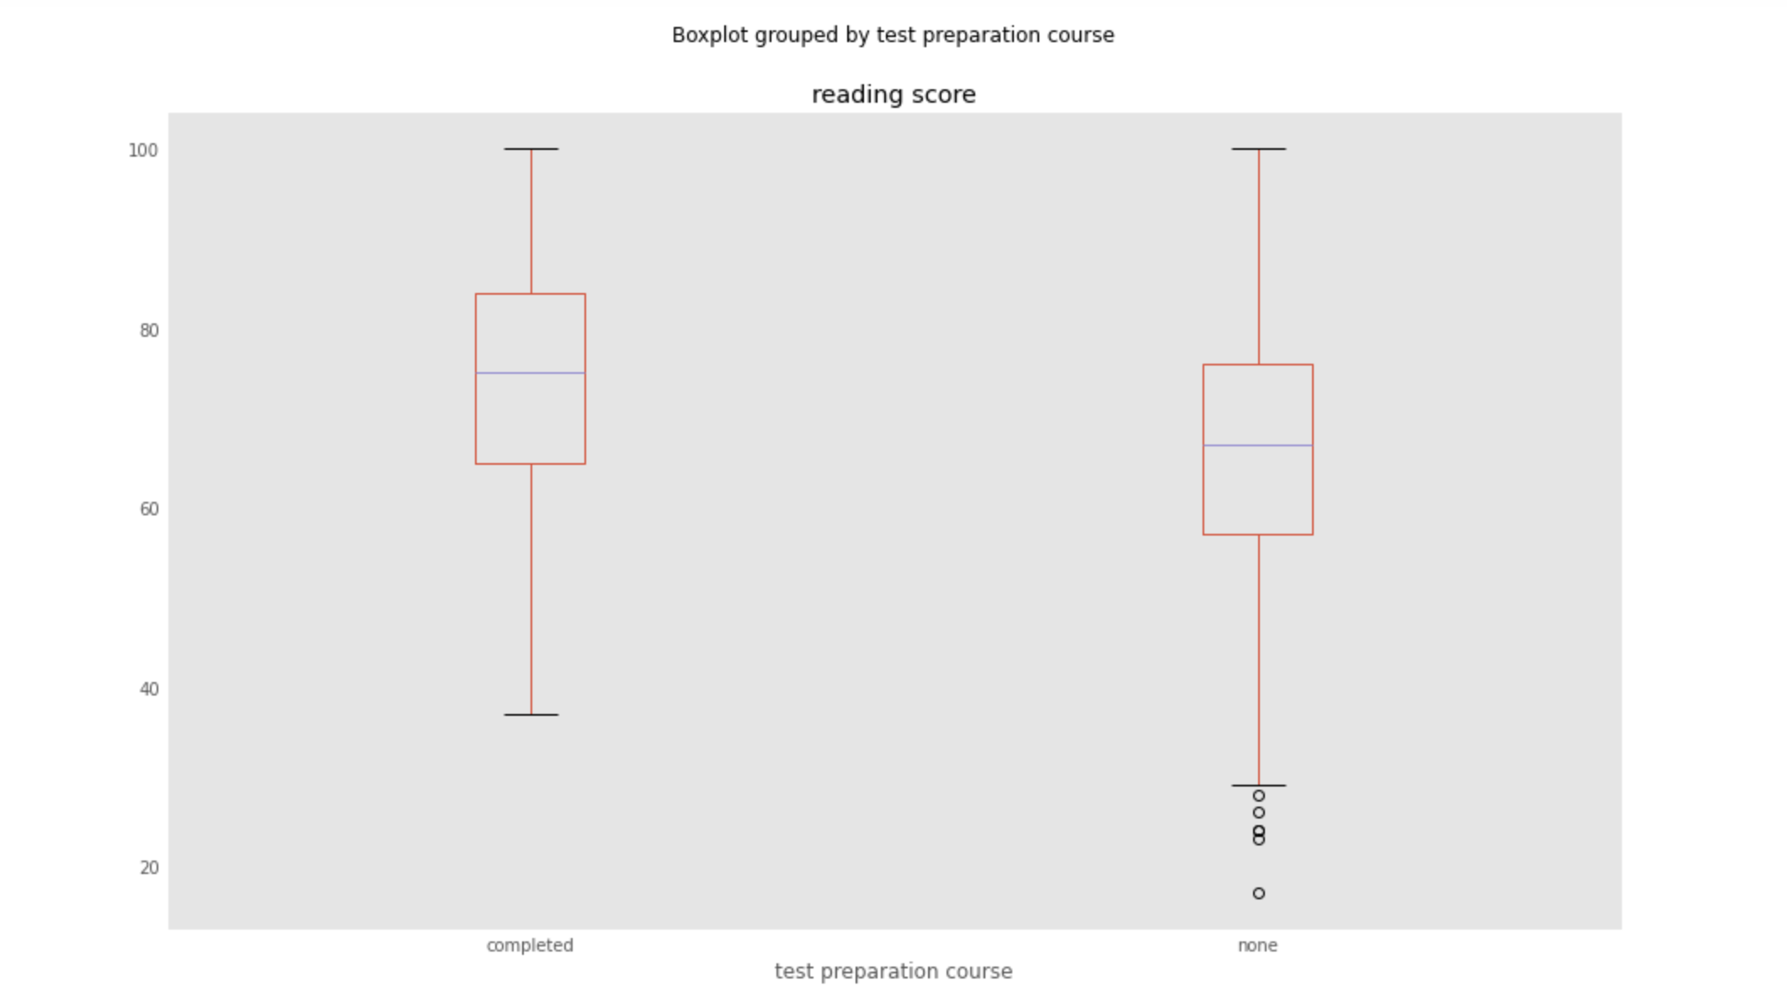
Notes:
Using the boxplot function in python, the data shows that in all the scores the average is higher when people completed the test preparation course compared to the people who didn’t take the course. As indicated by the purple line in the box, which is the median.

Slide 14
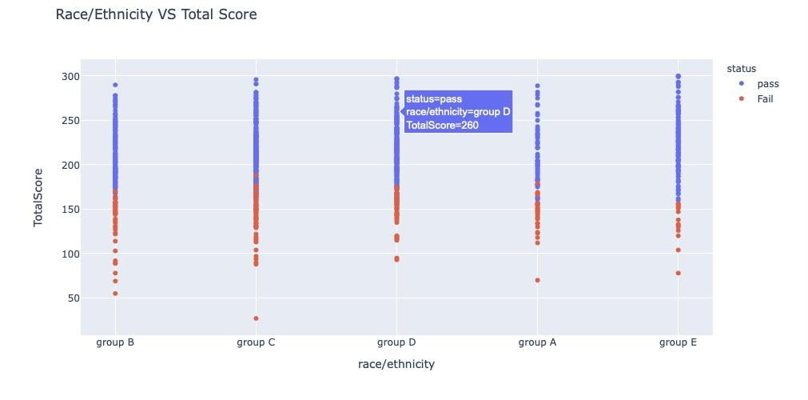
Does race/ethnicity affect students’ exam performance?

Slide 15
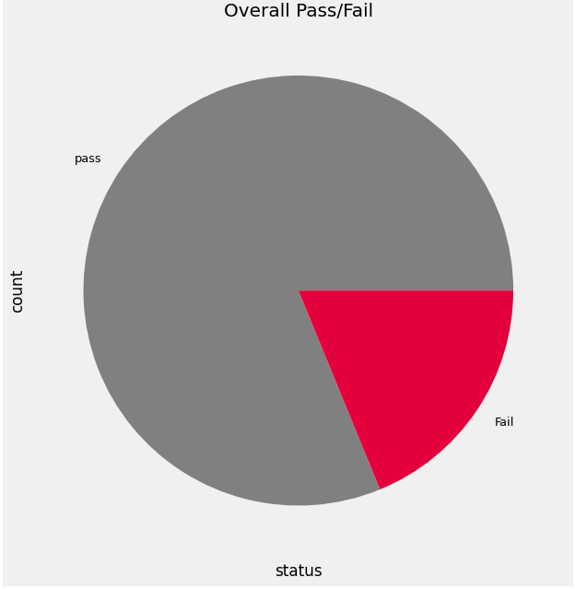
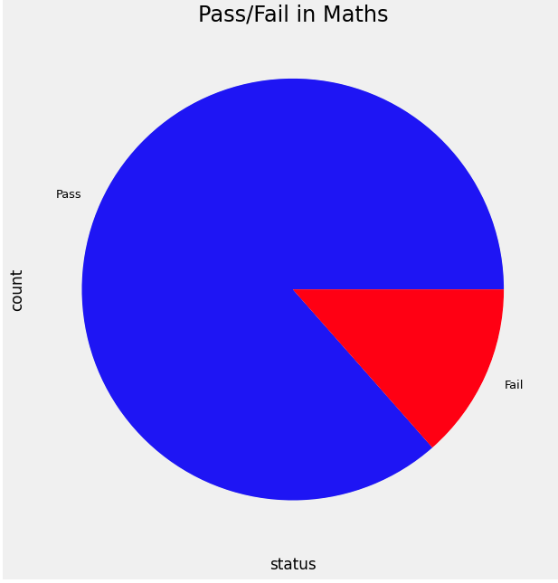
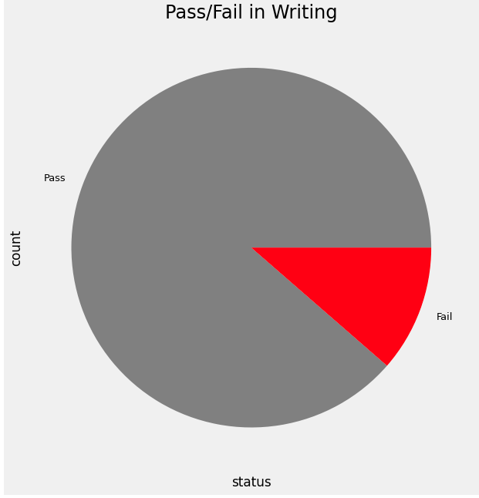
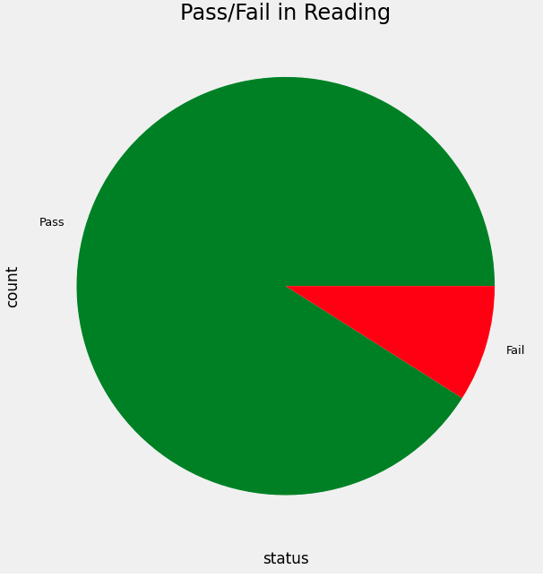
Implications
Parental education level
Test Prep
Reading score vs Math and Writing
Race/Ethnicity
Lunch statuses

Slide 16
Summary
Based on our analysis, we were able to conclude that many of the factors that influence the students’ score are in regards to how they prepare for the test and the educational background of their parents. Some factors that we found were inconclusive to the scores of the students were their gender and lunch plan which would require much more information to draw a conclusion from. We also were able to identify the trend between scores which showed that the student’s score in one subject will close in points from one another on average based on the p-value of .685.

Slide 17
Questions?

